Slide 1



Statistical analysis of metagenomics data
Xiangyu Li
Postdoctoral researcher
Science for Life Laboratory, KTH
xiangyu.li@scilifelab.se
Updated 2022

Slide 2
Schedule
UK course time | Sweden course time | Break time
10:00-10:50 | 11:00-11:50 | 10 mins
11:00-11:50 | 12:00-12:50 | 70 mins
13:00-13:50 | 14:00-14:50 | 10 mins
14:00-14:50 | 15:00-15:50 | 10 mins
15:00-15:50 | 16:00-16:50 | 10 mins
16:00-17:00 | 17:00-18:00 | -

Slide 3
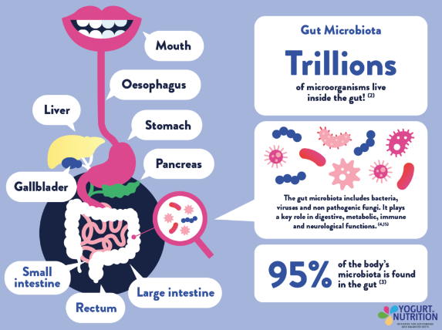
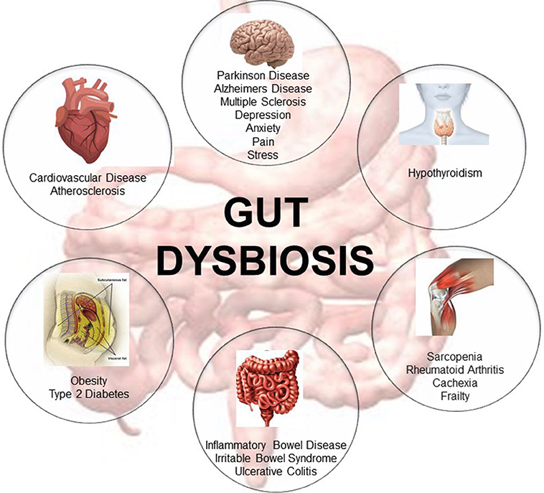
Main contents
Microbiome Diversity
Alpha diversity
Beta diversity
Statistical analysis of diversity
Differential analysis
Similarity analysis

Slide 4


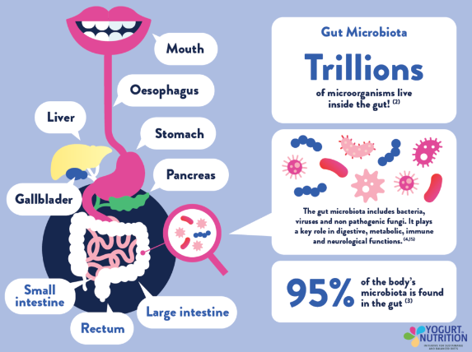
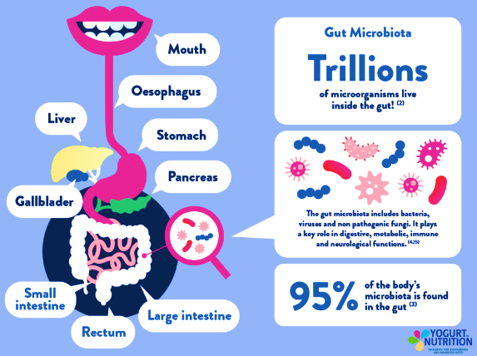
Alpha Diversity
Alpha diversity characterizes the species richness and/or evenness in a sample or area. Usually, we use a mathematical formula that considers the richness and evenness to estimate the alpha diversity.
Richness: the number of species type
Evenness: the distribution of different species or the proportion of different species
Within a sample or area
Sample 3
Sample 4
Sample 1
Sample 2
Type of species: 3
Lots of common types
Few of rare types
Low richness; Low evenness
Type of species: 3
Similar abundance
of each type
Low richness; High evenness
Type of species: 7
Lots of common types
Few of rare types
High richness; Low evenness
Type of species: 7
Similar abundance
of each type
High richness; High evenness
Notes:
Diversity of sample 2 is higher than sample 1. The diversity in sample 4 is higher than sample 3.

Slide 5
Alpha diversity
Richness
Observed species
Chao 1
ACE
Richness and evenness
Shannon
Simpson and InvSimpson

Slide 6
Alpha diveristy: richness
Observed species: the absolute number of species type
Species | Sample 1 (Abundance)
s__Varibaculum_cambriense | 0
s__Corynebacterium_accolens | 50
s__Rothia_dentocariosa | 0
s__Propionibacterium_granulosum | 20
s__Pseudomonas_putida | 30
Observed species?
3

Slide 7
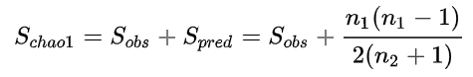
Alpha Diversity: richness
Chao1 index:
n₁: the number of species with abundance = 1
n₂: the number of species with abundance = 2
The observed number of species
Estimated number of unobserved species, which is esimated by rare species (abundance=1 or 2).
Note: Chao1 estimator is particularly useful for estimating the richness of samples with low-abandance species.
Species | Sample 1 (Abu) | Sample 2 (Abu)
s__Varibaculum_cambriense | 1 | 1
s__Corynebacterium_accolens | 96 | 1
s__Rothia_dentocariosa | 0 | 1
s__Propionibacterium_granulosum | 1 | 89
s__Pseudomonas_putida | 2 | 8
Calculate the Chao1 value for sample 1 and 2?
Sample 1: Chao1=4+2* (2-1)/2*(1+1)=4.5
Sample 2: Chao1=5+3* (3-1)/2*(0+1)=8
Ref: Chao A . Non parametric estimation of the number of classes in a population[J]. Scandinavian Journal of Statistics, 1984, 11: 265-270.
Notes:
OUT: Operational Taxonomic Units, can understand as abundance. The Chao richness estimator tend to use the rare species to infer the number of missing species.
Chao 1 is very sensitive to rare species.
Reference: https://www.jianshu.com/p/cd248f795c52
Chao 1984, chao指数越大，OTU数目越多

Slide 8
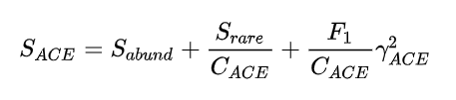
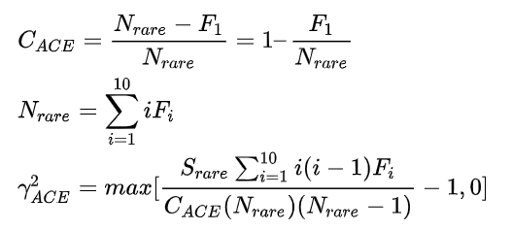
Alpha Diversity: richness
ACE index:
Abundance-based
coverage estimator
The observed number of species with abundance>10
The estimated number of species with 2<=abundance<=10
The estimated number of species with abundance=1
Note: ACE index considers the both low-abundance and abundance from 2 to 10.
S_{abund}: the observed number of abundant species (abundance>10).
S_{rare}: the observed number of rare species (abundance≤10).
C_{ACE}: Among rare species, abundance coverage (proportion) for the species with 2 ≤ abundance ≤ 10.
N_{rare}: total abundance for rare species
F_{i}: the number of species with abundance=i. Thus, F₁ is the number of species with abundance=1.
Species | Sample 1 (Abu)
s__Varibaculum_cambriense | 1
s__Corynebacterium_accolens | 1
s__Rothia_dentocariosa | 1
s__Propionibacterium_granulosum | 2
s__Pseudomonas_putida | 11
s__Ureaplasma_parvum | 15
When is the ACE value not available?
ACE is not available if there is no species abundance<=10, or only one species with abundance=1 and all other species >10.
8
Notes:
Chao and Yang 1993, ACE index: Abundance-based coverage estimator of species richness

Slide 9
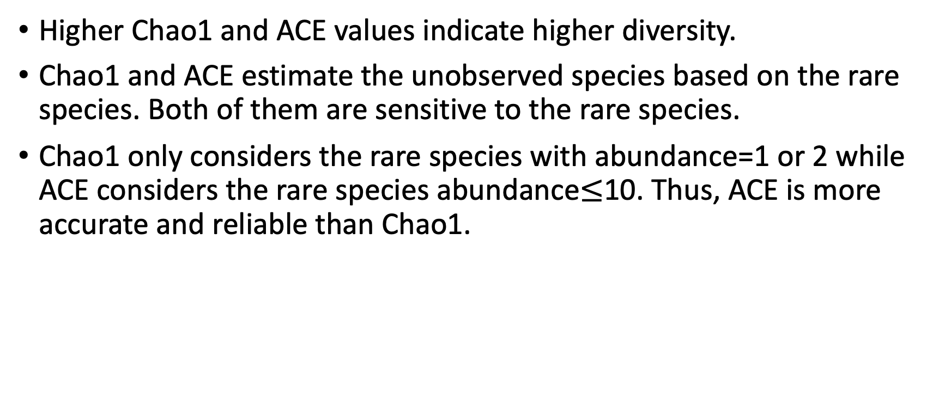
Chao1 vs ACE
Higher Chao1 and ACE values indicate higher diversity.
Chao1 and ACE estimate the unobserved species based on the rare species. Both of them are sensitive to the rare species.
Chao1 only considers the rare species with abundance=1 or 2 while ACE considers the rare species abundance$≤$10. Thus, ACE is more accurate and reliable than Chao1.

Slide 10

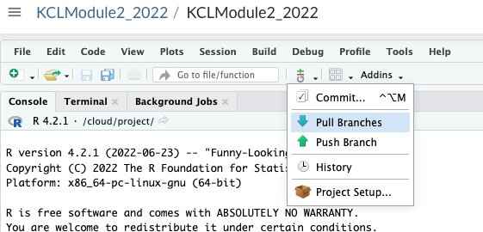
R studio cloud (Method 1)
R cloud: https://rstudio.cloud
If the method 1 doesn’t work for you, please use method 2 in next slide.

Slide 11
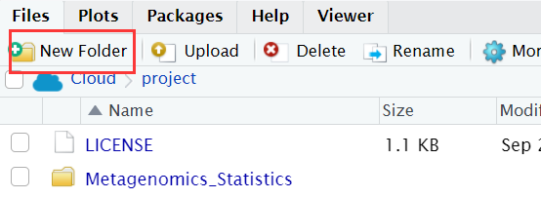
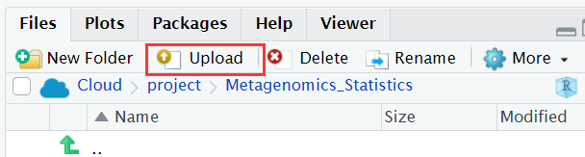
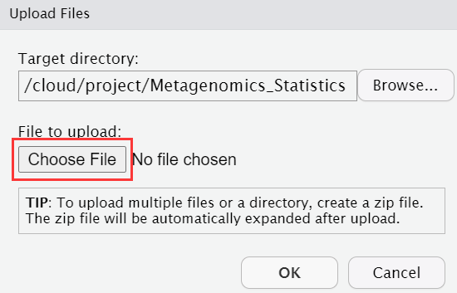
R studio cloud (Method 2)
1. Open https://github.com/sysmedicine/KCLModule2_2022, and download the materials to your local computer.
2. Open your R studio cloud, go to a working project.
3. Create a new folder called “Metagenomics_Statistics_2022” in the current directory.
4. Go to the above folder and upload the data by using ‘Upload’ icon.
Please upload our files
Go to R for next part

Slide 12
#load all the packages
library(tidyr)
library(dplyr)
library(tibble)
library(phyloseq)
library(microbiome)
library(vegan)
If there is any package that is not installed in your work space, please use codes as below.

Slide 13
#install “tidyr”
install.packages("tidyr")
#or
install.packages("devtools")
devtools::install_github("tidyverse/tidyr")
#install “dplyr”
install.packages("dplyr")
#Or
#install.packages("devtools")
devtools::install_github("hadley/lazyeval") devtools::install_github("hadley/dplyr")

Slide 14
#install “tibble”
install.packages("tibble")
#or
#install.packages("devtools")
devtools::install_github("tidyverse/tibble")
#install “phyloseq”
#Open Bionconductor website: https://www.bioconductor.org/; and search “phyloseq”
if (!require("BiocManager", quietly = TRUE)) install.packages("BiocManager")
BiocManager::install("phyloseq")

Slide 15
#install “microbiome”
#Open Bionconductor website: https://www.bioconductor.org/; and search “microbiome”
if (!require("BiocManager", quietly = TRUE)) install.packages("BiocManager")
BiocManager::install("microbiome")
#vegan is already packed in the package “microbiome”. You don’t need additionally install it. Just use the codes below.
library(microbiome)
library(vegan)

Slide 16
Task 1

Slide 17
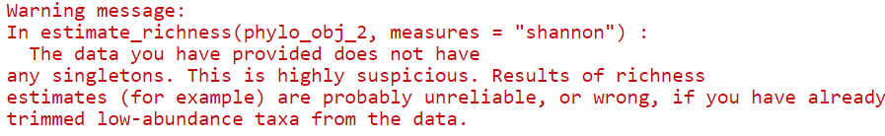
Warning
It is fine if you get this warning during the calculation of alpha diversity. Since we don’t have the rare species with singleton which means the species with abundance=1.

Slide 18
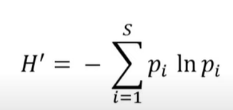
Alpha diversity: richness and evenness
Shannon index:
p_{i =} the abundance of each species / total abundance of all species
i: the i_{th} species
S is the number of all species
ln is a natural logarithm
Note: Higher Shannon index represents higher diversity

Slide 19
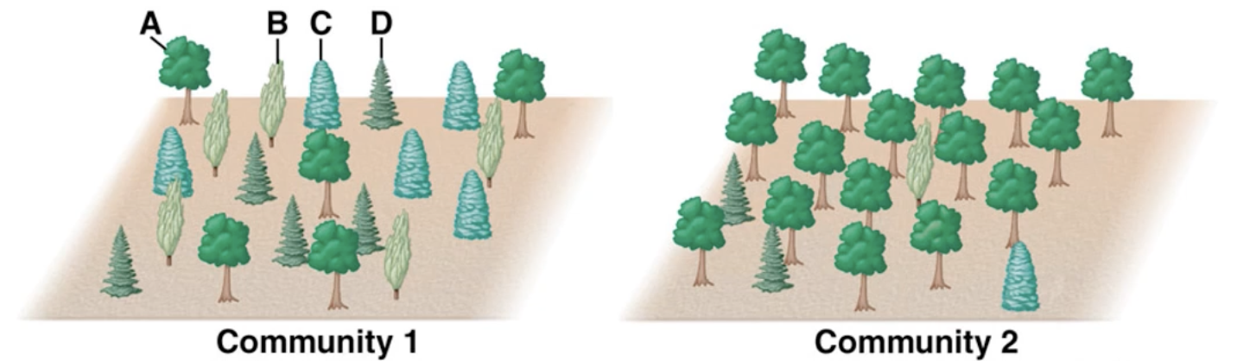
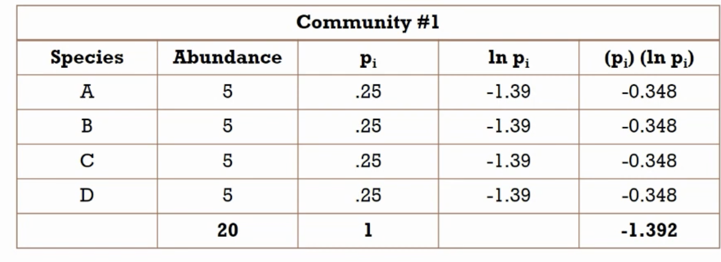
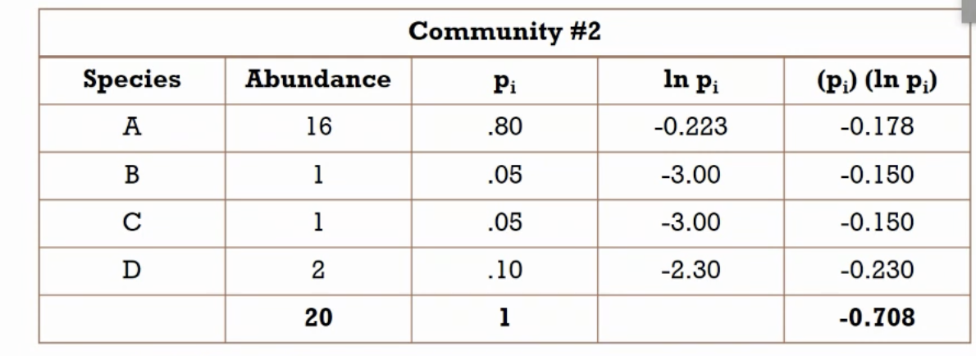
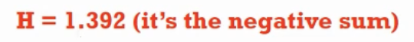
Alpha diversity: richness and evenness

Slide 20
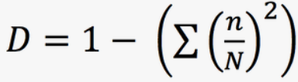
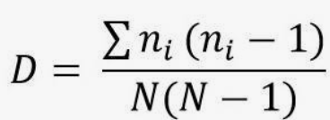
Alpha diversity: richness and evenness
Simpson D value:
or
n is the abundance of each species
N is the total abundance of all species
n/N is the proportion (P_{i}) of each species
Note: if we randomly select one species from the community, the probability that we catch a specific species is equal to n/N. Thus, if two individuals randomly selected species from an area, the probability that they get same species is equal to (n/N)².
Alternative formula:
Simpson= D
Simpson =1-D
InvSimpson= 1/(1-Simpson)
InvSimpson=1/D
Note: Higher D value means lower diversity. In phyloseq package: Simpson=1-D and InvSimpson=1/(1-Simpson). Thus, higher simpson and invsimpson values indicate higher diversity. The range of Simpson is from 0 to 1.
Notes:
http://www.countrysideinfo.co.uk/simpsons.htm
if we randomly select one species from the community, the probability that we catch the specific species i is equal to n/N.
Thus, D is that if we randomly select the species in a community, the probibility that we catch the same species. It the value is high, diversity is low.
Simpson:

Slide 21
Alpha diversity: richness and evenness
Species | Sample 1 | Sample 2 | Sample 3
s__Varibaculum_cambriense | 100 | 99 | 50
s__Corynebacterium_accolens | 0 | 1 | 50
Simpson1 = 1 – 1 = 0; InvSimpson = 1
Simpson2 = 1 - (0.99*0.99 + 0.01*0.01) = 0.0198; InvSimpson = 1.02
Simpson3 = 1 - (0.5*0.5 + 0.5*0.5) = 0.5; InvSimpson = 1/(1-0.5) = 2
Simpson =1-D
InvSimpson= 1/(1-Simpson)

Slide 22
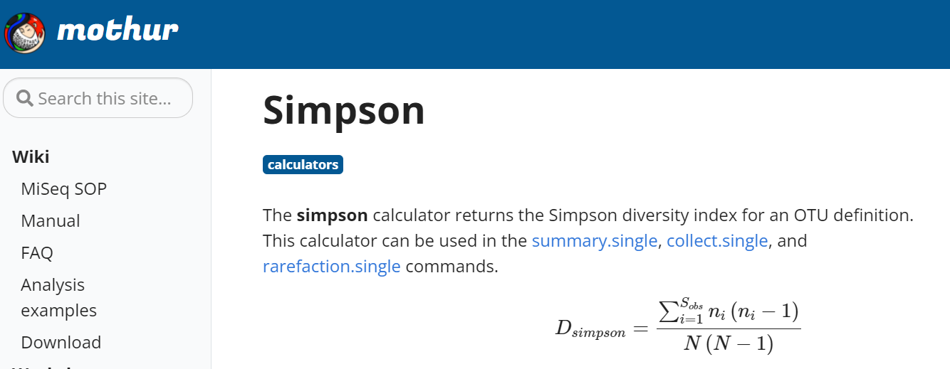
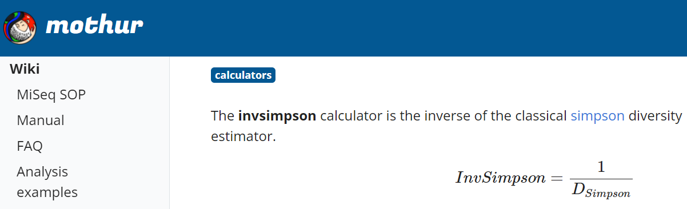
Be careful the formula of Simpson and InvSimpson in different tools!
In package mothur
Simpson=D
InvSimpson=1/D
High simpson indicates low diversity
High invsimpson indicates high diversity
Notes:
This Simpson is equal to d value

Slide 23
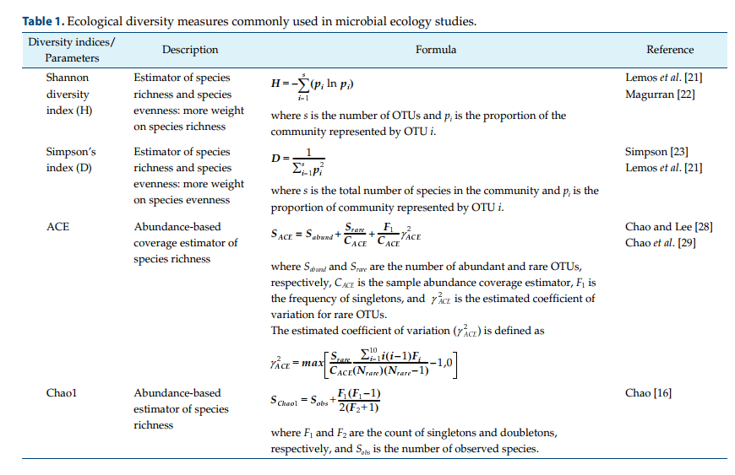
Conclusion
Go to R for next part
Kim, Bo-Ra, et al. "Deciphering diversity indices for a better understanding of microbial communities." Journal of Microbiology and Biotechnology 27.12 (2017): 2089-2093.

Slide 24
Task 2

Slide 25
Statistical Analysis
Distribution of the data
Choose the suitable test based on requirement
Calculation of P value: the probability that null hypothesis is true
Reject H₀ if P<0.05, otherwise accept H₀
Please reject H0 if P<0.05!
Notes:
Null hypothesis (H₀)

Slide 26
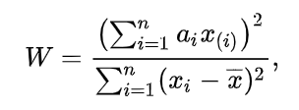
Normal distribution test
Shapiro–Wilk test
H0: The samples are from a normally distributed population.
H1: The samples are not from a normally distributed population.
Note: Shapiro-wilk test is suitable for small sample size.
P<0.05, reject H0, indicates these samples are not from a normal distribution.

Slide 27
Difference analysis
Student’s t test
Wilcoxon rank sum test

Slide 28
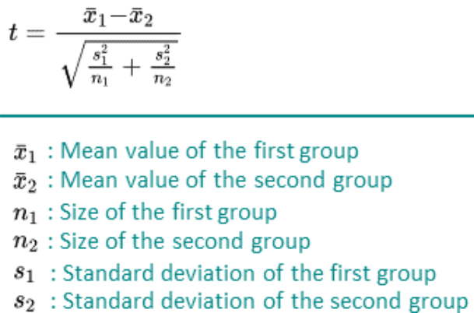
Unpaired student’s t test
Parametric method
Normal distribution
H0: The mean shannon values are equal between two groups.
H1: Not equal.

Slide 29
Wilcoxon rank sum test
Non-parametric method
Not require a specific distribution
H0: The median shannon values are equal between two groups
H1: Not equal.
1. Put the values together and rank them based on a increasing order.
2. Calculate the rank for each value.
3. Calculate the sum of rank for each group (W1 and W2)
4. If sample size n1<n2, W=W1; if n1=n2, W=W1 or W2.
Go to R for next part

Slide 30
Task 3

Slide 31
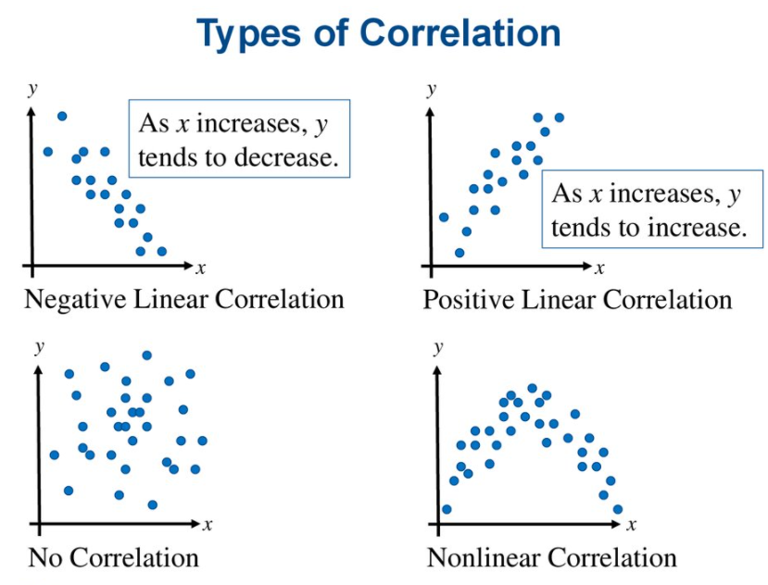
Linear correlation vs non linear correlation
Linear correlation: the ratio of change is constant.
Notes:
Coefficient r is t distribution. This we could caluculate the p value based on statistic t.

Slide 32
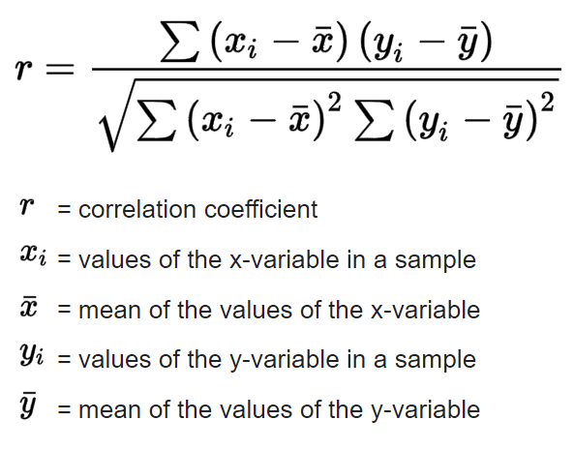
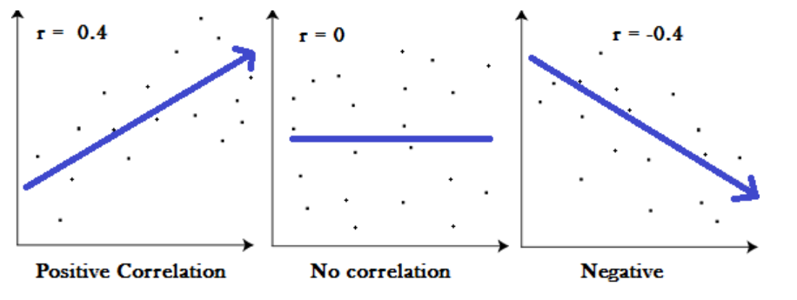
Linear correlation
Pearson correlation
Normal distribution
Spearman correlation
No required distribution
H₀: The correlation coefficient is equal to 0.
H₁: Not equal to 0.
Pearson correlation coefficient
-1≤r ≤1, higher absolute r value means more correlated. r>0 indicates positively correlated. r<0 indicates negatively correlated.
Go to R for next part
Notes:
Pearson's correlation coefficient follows Student's t-distribution

Slide 33
Task 4

Slide 34
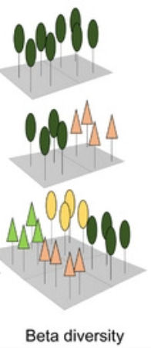
Beta diversity
Beta-diversity is a measure of the similarity or dissimilarity of two communities.
Beta-diversity is measured by distance.
Sample 1
Sample 2
Sample 3

Slide 35
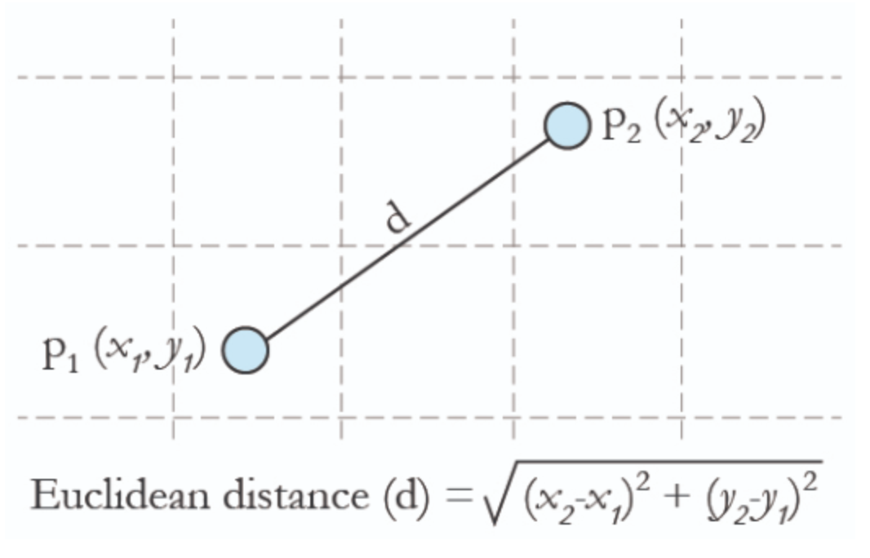
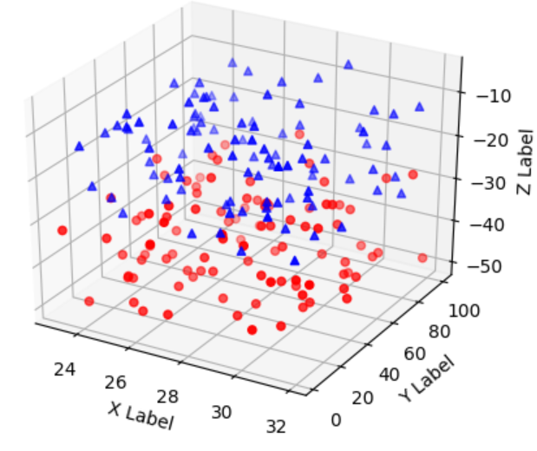
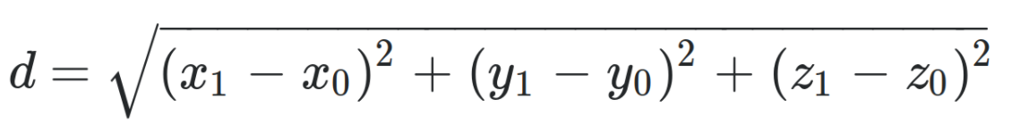
Beta diversity: distance measurement
Euclidean distance is the difference of two points in one-dimension space.
Two-dimension space
Three-dimension space
Note: Higher distance means larger difference of diversity between samples

Slide 36
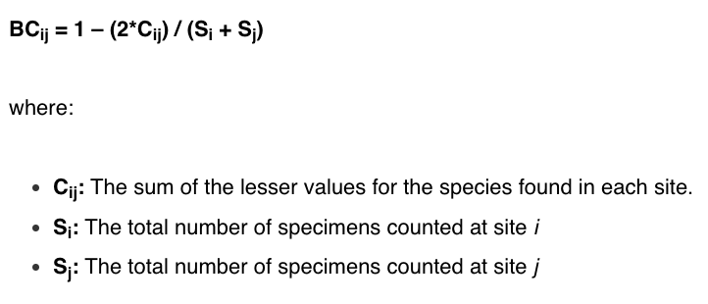
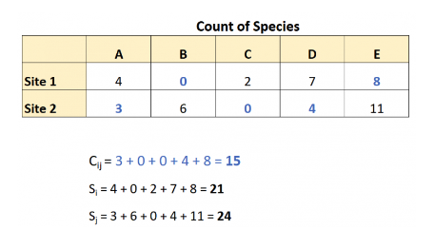
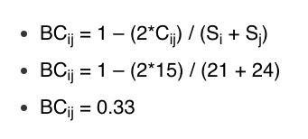
Beta diversity: distance measurement
Bray-Curtis distance
Note: The Bray–Curtis value ranges from 0 and 1, where 0 means the two sites have the same composition (that is they share all the species), and 1 means the two sites do not share any species.

Slide 37
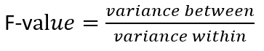
Compare beta diversity between groups
.
Permutational multivariate analysis of variance (PERMANOVA)
Non-parametric test
No required distribution
Difference between groups
Individual difference
H0: The average of the within-group distances equal to the average of the between-group distances.
H1: The average of the within-group distances is not equal to to the average of the between-group distances.
p<0.05, variance between groups is significantly higher than variance within groups, there is biological difference between two groups.
Notes:
https://esajournals.onlinelibrary.wiley.com/doi/10.1890/12-2010.1

Slide 38
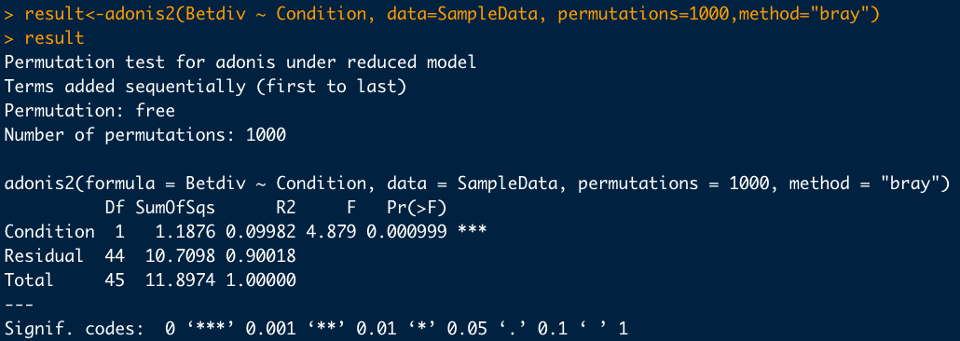
R²=9.98%: 9.98% of the variance can be explained by the group difference.
F is the statistic. Higher F value means bigger difference of diversity between groups.
P <0.01, the beta diversity between two groups is significantly different.

Slide 39
Homework
Are there any species whose relative abundances are significantly different between disease and normal?
Are there any species whose relative abundances are correlated with alpha diversities, BMI or age?

Slide 40
Thank you !

